Slide 1
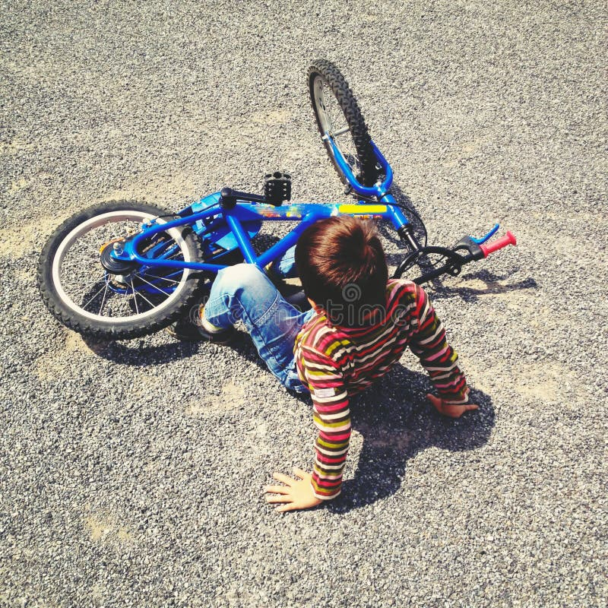
How many times did you fall before successfully
riding a bicycle the first time ever?

Slide 2
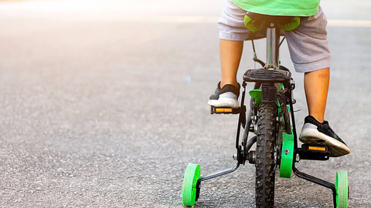
You tried again. You fell less. You found your balance. Through trial and error, you optimized your movements until you could ride effortlessly.

Slide 3

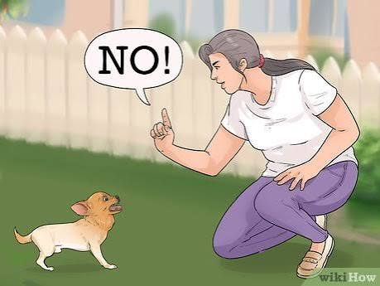
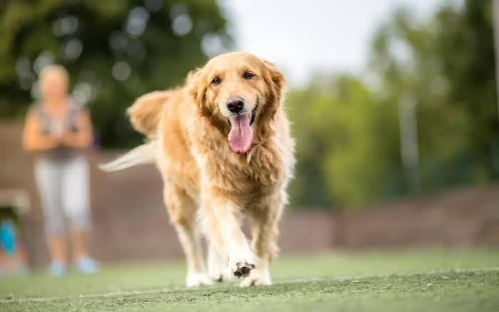
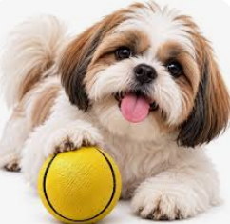
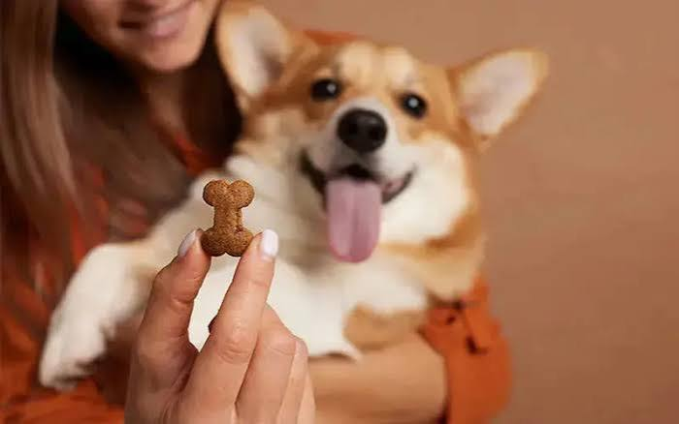
We Learn by Trial and Error (Based on Experience)
Undesirable Action
Negative Reinforcement
(-Reward)-> Scoldings
Agent
Desirable Action
Reinforcement (+Reward)-> Snack

Slide 4
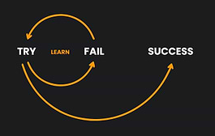
Reinforcement Learning
Dr. Nimrita Koul
https://www.linkedin.com/in/nimritakoul/

Slide 5
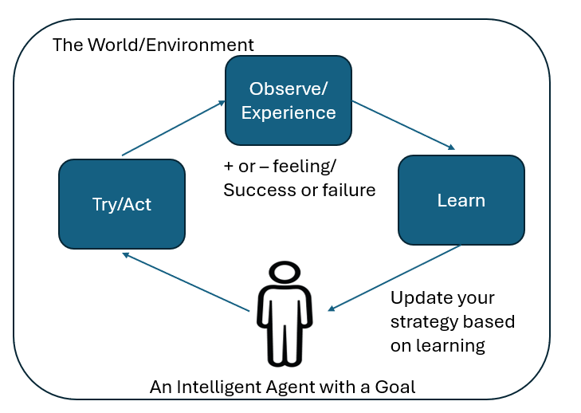
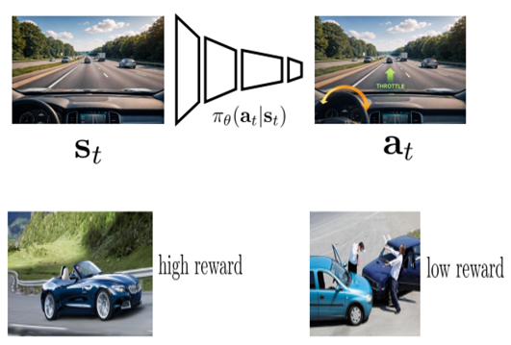
Learning based on Reinforcements

Slide 6
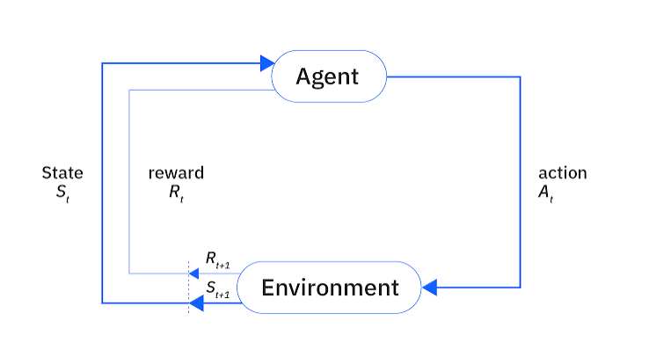
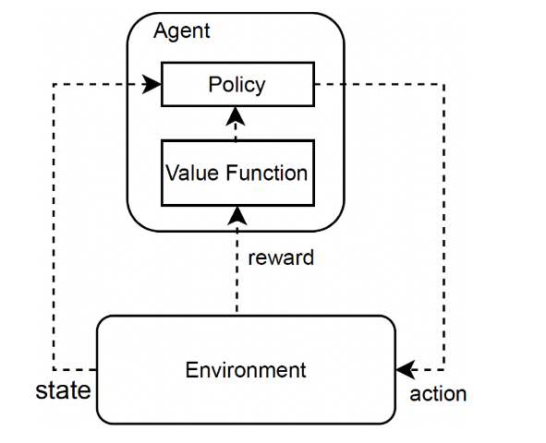
Agents Learn based on Reinforcements (Feedback Signal) from the Environment
https://web.stanford.edu/class/psych209/Readings/SuttonBartoIPRLBook2ndEd.pdf
Source Credits: https://encyclopedia.pub/entry/49960
The Goal of an Intelligent Agent is to Maximize its Cumulative Reward.

Slide 7
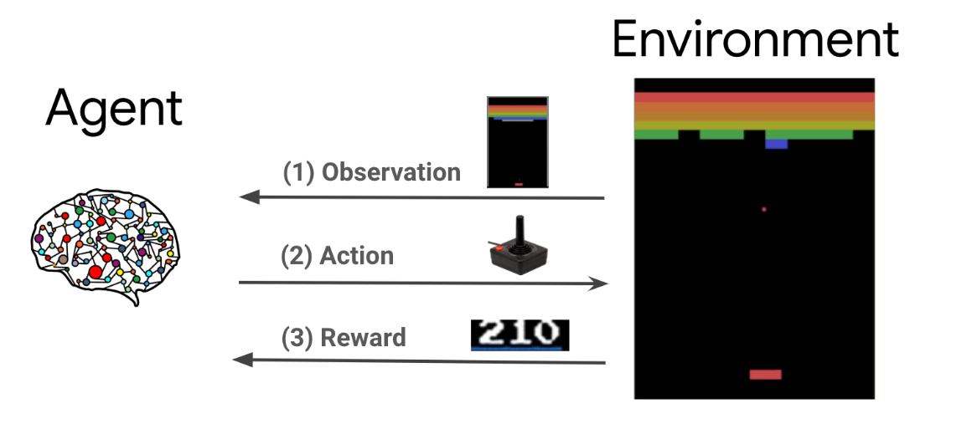
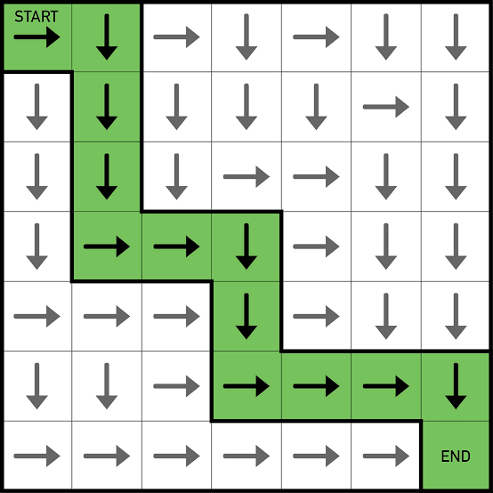
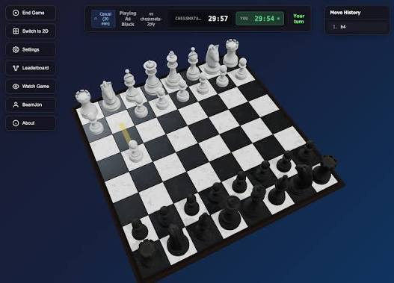
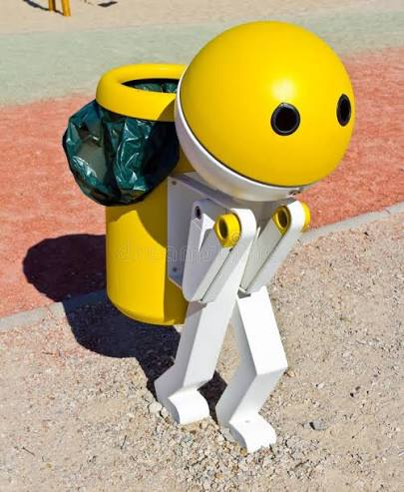
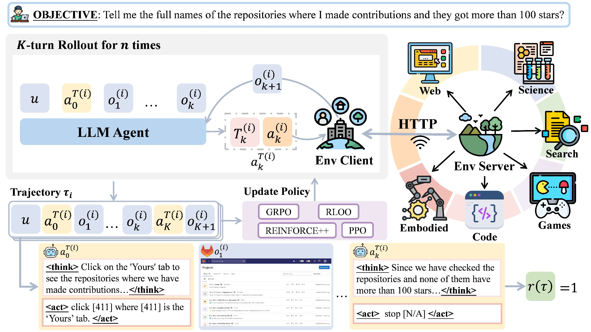
Environment is the World Available to the Agent

Slide 8
Reinforcement Learning
RL is the study of how agents learn by trial and error.
Rewarding or punishing an agent for its behaviour makes it more likely to repeat or avoid that behaviour in the future.
Applications: Automation and Robotics, Self Driving Cars, training generative AI models, Finance, Gaming etc.

Slide 9
Main components in RL
Agent.
Environment.
Reward.
Return.
Policy.
Reinforcement learning is a set of techniques that enable the agent to learn behaviours (policy or a set of sequential actions to take) that let it achieve its goal.

Slide 10
Other Components in RL
States and observations. Real-valued vector, matrix, or higher-order tensor. Fully or partially observable.
Action spaces. Discrete or Continuous.
Policies. Which action to take in a particular state?
Trajectories. A sequence of states and actions in the world.
Value functions. Expected value of a state or a state-action pair.

Slide 11
Value Functions
Value of a state or a state-action pair is the expected return (a number) if you start in that state or state-action pair, and then act according to a particular policy forever after.
Value functions give you an expected value of a state or a state-action pair.

Slide 12
Four Types of Value Functions
On-Policy Value Function: If you start in a state and always follow a policy thereafter
On-Policy Action-Value Function: If you start in a state, take an arbitrary action, and then always follow the policy.
Optimal Value Function: If you start in a state and always act according to the optimal policy.
Optimal Action-Value Function: If you start in a state, take an arbitrary action, and then always follow the optimal policy.

Slide 13
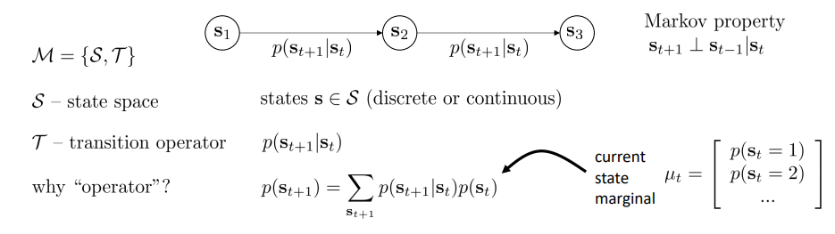
Markov Chain (after Andrey Markov)
The future state of a system depends only on the current state and the current action(Markov Property).
Basic probabilistic model of a dynamical system.

Slide 14
Markov Decision Process
A Markov Decision Process (MDP) is a mathematical framework for modelling agent-environment interactions in RL.
It is written as a tuple : (S, A, T, R, γ)
  State Space (S
  Action Space (A)
  Transition Function / Probability (P or T): The probability P(s’|s, a) of moving to a next state s' given the current state s and action a.
  Reward Function (R): The feedback function R(s, a, s') or R(s, a) that assigns an immediate numerical reward (or penalty) after transitioning.
  Discount Factor (γ): Optional value between [0, 1] used in infinite-horizon or continuous tasks to weigh the value of future rewards relative to immediate ones

Slide 15
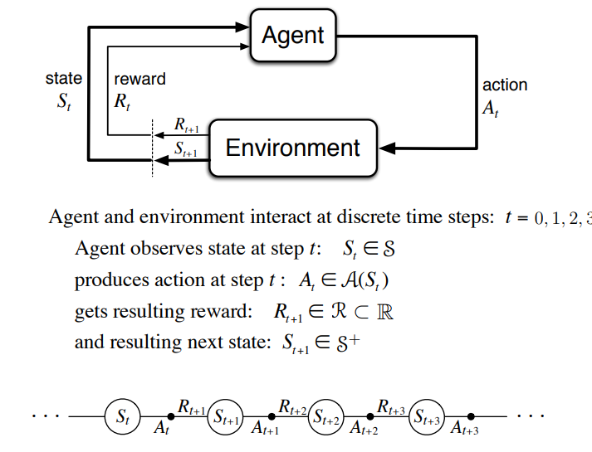
MDP
https://web.stanford.edu/class/cme241/lecture_slides/rich_sutton_slides/5-6-MDPs.pdf

Slide 16



The RL Problem
The goal in RL is to learn / select a policy which maximizes expected return when the agent acts according to it.
Transition probability is given by:
The expected return (J(π)) is:
The central optimization problem in RL can then be expressed by:

Slide 17
Bellman Equations
All four of the value functions obey special self-consistency equations called Bellman equations. Bellman Equations say that:
The value of your starting state is the reward you expect to get from being there, plus the value of the next state you may go to.
V(s_{t}) = R(s_{t}) + V(S_{t+1})

Slide 18
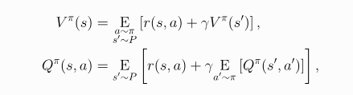
Bellman Equations for the on-policy value functions

Slide 19
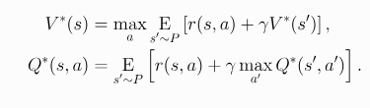
Bellman equations for the optimal value functions
In optimal value function, every action the agent chooses must be the highest value action.

Slide 20
What is to be learned by an Agent in RL?
Policies (stochastic or deterministic).
Action-value functions (Q-functions).
Value functions.
Environment models.
Model-Free vs Model-Based RL : Model of the environment is a function which predicts state transitions and rewards.

Slide 21
What is to learned by an Agent in Model-Free RL?
1. Policy Optimization. Optimal Policy. To optimize a policy π_{θ}(a|s), optimize θ by gradient ascent on the performance objective J(π_{θ}). Mostly on-policy. E.g., A2C / A3C, PPO.
2. Q-Learning. Q-Table. Learn an approximator Q_{θ} (s,a) for the optimal action-value function, Q* (s,a). Mostly off-policy. E.g., DQN, C51

Slide 22
What is to be learned by an Agent in Model-Based RL?
Pure Planning
Embedding Planning Loops into Policies
Data Augmentation for Model-Free Methods to train a policy or Q-function.
An explicit representation of the policy, π_{θ}(a|s).

Slide 23
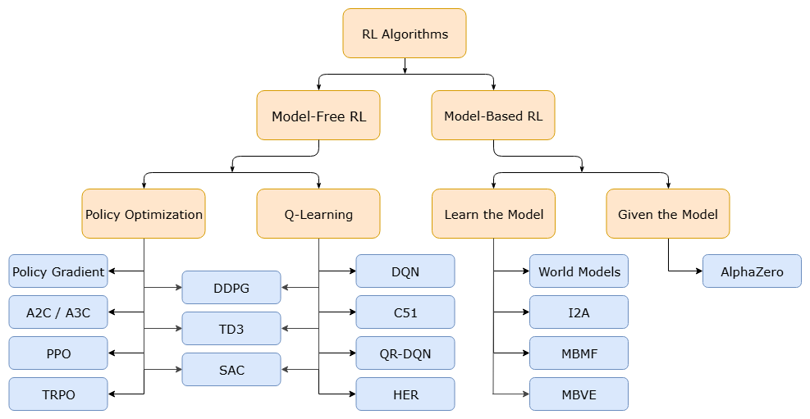
Types of RL Algorithms
Source Credits: https://spinningup.openai.com/en/latest/spinningup/rl_intro2.html

Slide 24
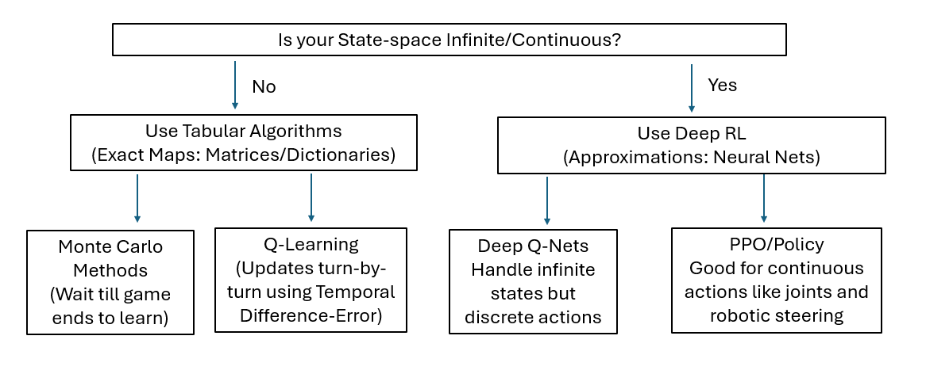
Choosing the Right RL Algorithm

Slide 25
Choosing the Right RL Algorithm
Strategy | Example Algorithm | Use Case | Approach
Tabular | Monte Carlo (MC) | Small, finite systems with clear, short termination rules (e.g., Blackjack, Tic-Tac-Toe). | Play out an episode. Once it's over, look backwards and score every action based on the outcome.
 | Q-Learning (TD) | Simple physics environments with low state counts. | Update Q-table turn-by-turn based on the instant reward and prediction of the next step.
Deep RL | Deep Q-Network (DQN) | Complex systems with raw continuous observation states but discrete inputs e.g. Atari Games | There is no Q-table. Train a Neural Network to predict the value of each action.
 | Policy Gradient (PPO/SAC) | Robotics, autonomous driving, or character locomotion with continuous actions. | Directly optimize the control neural network to output the precise action to take.

Slide 26
Hands-On Code

